Slide 1
Legal Environment of Business – Law 2023
Jeffrey Pittman
Fall 2011

Slide 2
Course Keys for Success
Working & Persevering
Seeing
Analyzing

Slide 3
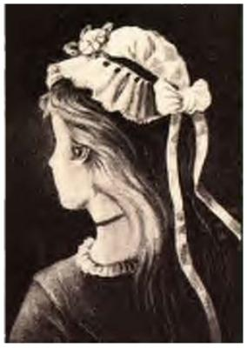
Seeing &Optical Illusions
Once you “see” (learn, understand) something, you will own and remember the item
See Squidoo
  Once you see both sides of the illusions, you retain that memory

Slide 4
Working & Persevering
Don't be afraid to give your best to what seemingly are small jobs. Every time you conquer one it makes you that much stronger. If you do the little jobs well, the big ones will tend to take care of themselves. ~Dale Carnegie

Slide 5
Working & Persevering
With ordinary talent and extraordinary perseverance, all things are attainable. ~Thomas Foxwell Buxton
As a means to success, determination has this advantage over talent - that it does not have to be recognized by others. ~Robert Brault

Slide 6
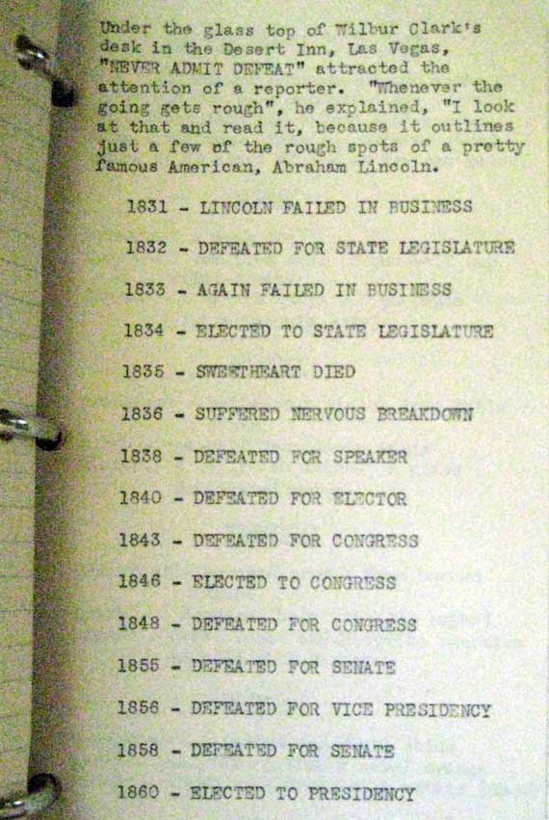
Analyzing
Do not blindly accept an item presented
For example, consider the often-cited list of Abe Lincoln’s “failures,” opposite

Slide 7
Analyzing
See Snopes.com’s analysis of the prior “Abe Lincoln's failures”
In short, do not believe everything you read
  Critique information by analyzing the source of the information, research key questions in multiple venues, and analyze everything for logic and consistency

