Slide 1
Cyberlaw & E-Commerce
Trademark Class Topics

Slide 2
Trademark Introduction
For an interesting introduction to trademark law, read Trademarks: Fingerprints of Commerce

Slide 3
Topic 1 –Trademark Valuation
Intangible assets include intellectual property (trademarks, trade secrets, patents, and copyrights) and other legal rights (such as exclusive distribution contracts)
For at least two types of businesses, the value of intangible assets far exceeds the value of tangible assets
  High tech firms that make large investments in research and development – for example, pharmaceutical, biotech and computer firms
  Branded consumer products firms that make large expenditures in advertising and brand building activities

Slide 4

Topic 1 – Trademark Valuation (cont.)
In 2002, Interbrand estimated the “Coca-Cola” trademark was worth $70 billion*
* Source: Special Report: The 100 Best Brands, Bus. Wk., Aug. 5, 2002, at 95

Slide 5
Topic 2 – Bases for Trademark Value
Trademarks greatly enhance a product’s sales and market share
  For example, as of 2002 Gatorade maintained an 80% market share while PepsiCo’s All Sport brand was able to achieve only a 4% share, despite aggressive advertising, superior distribution capabilities and a substantially similar product and price*
  * Magid et al., Quantifying Brand Image: Empirical Evidence of Trademark Dilution, 43 Amer. Bus. Law J. 1, at 8 (2006)

Slide 6
Topic 2 – Bases for Trademark Value (cont.)
Consumers may be willing to pay a premium for a known trademark and brand
  For example, many consumers are willing to pay a 400% premium for Bayer aspirin over generic aspirin*
A known trademark can reduce the expense of launching a new product
  For example, in 1998 Caffeine-Free Diet Coke was the ninth best selling soft drink in the US, despite spending nothing for advertising*
  * Id.

Slide 7
Topic 3 – Trademark Scenarios
Analyze the presented scenarios from the textbook, pages 422-424

Slide 8

Topic 4 – Generic Marks
Textbook pages 425-428
What legal trademark danger lurks for companies such as Kleenex, Xerox,
or Coke?
How does the opposite picture illustrate a legal strategy?

Slide 9
Topic 4 – Generic Marks (cont.)
For other examples, see
Sheetrock - http://www.usg.com/index.jsp
Bush Hog - http://www.bushhog.com/

Slide 10
Topic 4 – Generic Marks (cont.)
In addition to the aforementioned marks, other trademarks currently thought to be in danger of being generic include
  iPod
  Jell-O
  Band-Aid
  Rollerblade, and
  Google

Slide 11
Topic 4 – Generic Marks (cont.)
Trademarks which have been genericized in at least some countries include the following
  Champagne
  Hot Dog
  Thermos
  Ice Cream
  Formica
  Escalator
  Trampoline
  Raisin Bran
  Linoleum
  Dry Ice
  Shredded Wheat
  Yo-Yo
  Kerosene
  Cornflakes
  Cube Steak
  Lanolin
  Aspirin
  the Allen wrench
  Masonite
  Cola
  Styrofoam
  Heroin
  Bikini
  Zipper

Slide 12
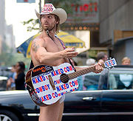
Topic 5 – Naked Cowboy
Chapter 10 overview
Analyze a lawsuit filed by the Naked Cowboy sues Clear Channel
  What type of trademark is the
  Naked Cowboy?
  See also Naked Cowboy Lawsuit
Background on the Naked Cowboy
Naked Cowboy Website
Search for Naked Cowboy registered trademarks

Slide 13
Topic 6 – Trademark Protection for Product Characteristics
Textbook pages 433-445
Could a firm gain trademark protection for its website’s layout, considering fonts, sounds, and colors?
For Sound Trademarks, see this page from the USPTO
  Follow the directions for other non-traditional searches

Slide 14
Topic 7 – Trademark Infringement
Analyze Lamparello v. Falwell under
  Trademark infringement
  Initial interest confusion
  Cybersquatting, and
  Dilution claims
  See Lamparello’s website by using the Wayback Machine and typing www.fallwell.com
Compare Lamparello to AMF Inc., textbook pages 451-454

Slide 15
Topic 7 – Trademark Infringement (cont.)
Mattel versus Walking Mountain Productions

Slide 16
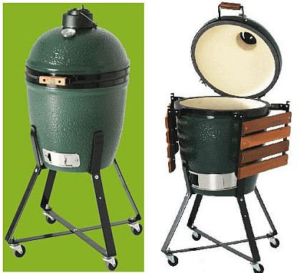
Topic 8 – Big Green Egg Smoker and Grill
Could the Big Green Grill company protect the color and shape of their cookers?
How does this compare to Traffix Devices, Inc., textbook pages 442-443?

Slide 17
Topic 9 – AMF v. Sleekcraft Boats
Explain the court's holding in AMF v. Sleekcraft

