Slide 1
Cyberlaw & E-Commerce
Copyright Topics - 2010
Chapters 7 & 9

Slide 2
Topic 1- Copyright Protection - Original Expressions
Textbook pages 258-264
From page 260, analyze Feist Publications v. Rural Telephone
Fantasy leagues use real data, usually from sporting events, to engage in simulated competition
Analyze a lawsuit between C.B.D. Distribution and Major League Baseball over unauthorized fantasy league use of players names and statistics [505 F.3d. 818 (8th Cir. 2007)]
From page 264, analyze protection available to the Website www.vggallery.com
Note the copyright notice on old Van Gogh letters; in this regard, see U.S. Copyright Circular 15A

Slide 3
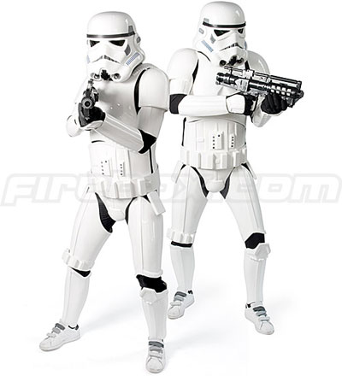
Topic 2 – Copyright & Product Designs
Textbook pages 264-69
Consider the George Lucas lawsuit regarding the Star Wars storm troopers
Would the storm troopers be protected under U.S. copyright law?
Compare this to Brandir, page 266

Slide 4
Topic 2 – Copyright Rights
Textbook pages 269-78
(Derivative) Analyze the issues involved in the President Obama “Hope” poster
Analyze the difference between infringement and fair use
(Performance) Could an elementary school teacher play Lion King during rainy days?

Slide 5
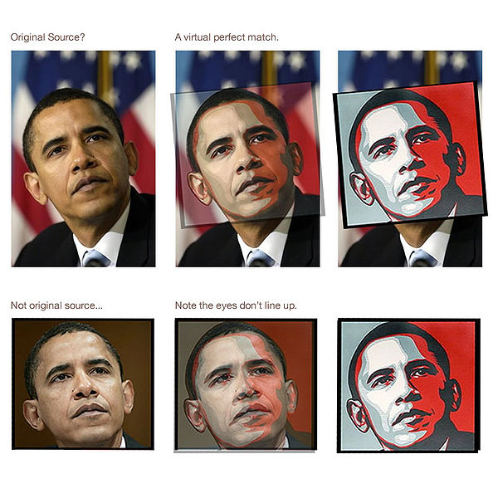
Topic 2 (Cont.) – Hope Poster
Regarding fair use and copyright ownership, analyze Photographer Wants In On Fairey Lawsuit
Who owns the copyright to President Obama photograph?
The Fairey poster?
Can Fairey sell his poster?

Slide 6
Topic 2 (Cont.) – Copyright Rights
(Performance) Could a restaurant owner play his personal music collection over the restaurant sound system?
(Derivative ) Could an author produce a sequel to J. D. Salinger’s “The Catcher in the Rye?”
See Judge blocks publication of J.D. Salinger spinoff book

Slide 7
Topic 3 – Fair Use or Infringement?
Analyze the following fair use problems using the fair use visualizer from Benedict.com
2LiveCrew and Pretty Woman
The Hope poster (prior slide)
The Catcher in the Rye sequel (prior slide)
From the textbook, UMG Recordings (page 280) and Kelly v. Arriba (page 281)

Slide 8
Topic 4 – Copyright Ownership
Who owns a copyright?
See Reid, textbook page 287
See Calatrava and his bridges
Notice the copyright dispute about changes to one bridge
In that regard, see The Patry Copyright Blog

Slide 9
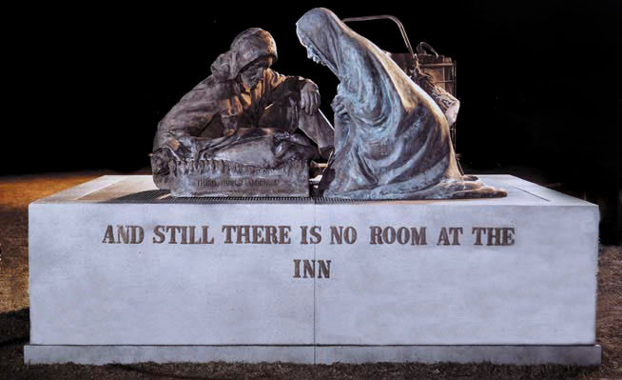
Topic 4 (Cont.) – Copyright Ownership & CCNV v. Reid
CCNV conceived the idea for the work to the right – a modern nativity scene
Can you legally protect ideas like this?
CCNV selected the title, “Third World America” and the legend on the base
Can you legally protect the title and legend?

Slide 10
Topic 4 (Cont.) – Copyright Ownership & CCNV v. Reid
Who owns the physical sculpture “Third World America”?
Who owns the copyright?
Economics Rights?
Moral Rights?

Slide 11
Topic 5 – Right to Privacy & Publicity
Could President Obama become a party to the litigation regarding the Hope poster, claiming a right to publicity?
Compare this question to Comedy Productions v. Saderup

Slide 12
Topic 5 – Damages & Copyright Duration
Regarding damages, see Minnesota song-sharing case heads for 3rd trial
Regarding duration, see
Copyright Basics or
WHEN U.S. WORKS PASS INTO THE PUBLIC DOMAIN

Slide 13
Topic 6 – Chapter 9
For Chapter 9, we will review the Chapter 9 Overview

