Slide 1
Cyberlaw and E-Commerce
Chapter 1
Jeffrey Pittman, Cyberlaw & E-Commerce 2010

Slide 2
Topic #1
Business Examples
In group settings
  Identify a real or hypothetical business,
  Identify several of the important intangible assets owned by the business, and
  Describe the basic legal protections available in the U.S. for the assets
    See Exhibit 1.2, textbook page 10, and the following four slides

Slide 3
Traditional Business Assets
Tangible Assets
Buildings
Inventory
Other tangible Assets
Cash
Accounts Receivable

Slide 4
Non-tangible Assets
Intellectual Property
Copyrights
Trade Secrets
Patents
Trademarks
Other IP

Slide 5
IFRS 3
The International Financial Reporting Standards (IFRS) are standards, interpretations and the framework adopted by the International Accounting Standards Board (IASB)
The following slide is a snapshot of Brand Finance’s presentation of IFRS 3

Slide 6
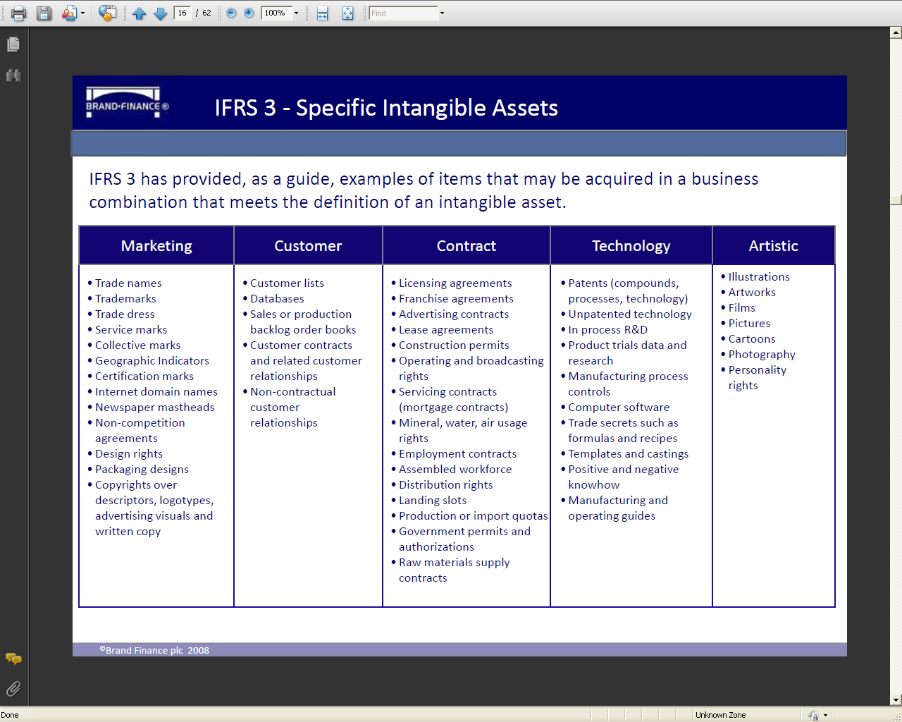

Slide 7
Topic #2
Federalism
Using the results from Topic #1, above, discuss the interaction of federal and state laws as illustrated in Exhibit 1.3 and 1.4, textbook pages 14 and 16

Slide 8
Topic #3
Free Speech
Apply the First Amendment, free speech (textbook pages 20-23) , to the Google/China dispute below
  No Sign Other Companies Will Emulate Google’s Stand Over China
  Clinton talk may signal China-Google direction

Slide 9
Topic #4
Food for Thought
Consider the following quotation (taken for a larger statement about the topic) from Thomas Jefferson

Slide 10
Thomas Jefferson
“If nature has made any one thing less susceptible than all others of exclusive property, it is the action of the thinking power called an idea, which an individual may exclusively possess as long as he keeps it to himself; but the moment it is divulged, it forces itself into the possession of everyone, and the receiver cannot dispossess himself of it. Its peculiar character, too, is that no one possesses the less, because every other possesses the whole of it. He who receives an idea from me, receives instruction himself without lessening mine; as he who lights his taper at mine, receives light without darkening me.”

Slide 11
Thomas Jefferson
“That ideas should freely spread from one to another over the globe, for the moral and mutual instruction of man, and improvement of his condition, seems to have been peculiarly and benevolently designed by nature, when she made them, like fire, expansible over all space, without lessening their density in any point, and like the air in which we breathe, move, and have our physical being, incapable of confinement or exclusive appropriation."

Slide 12
Thomas Jefferson
Source: Thomas Jefferson, Political Writings (Joyce Appleby, Joyce Oldham Appleby &Terence Ball, eds., Cambridge Univ. Press 1999), p. 580

