Slide 1
Teacher Made Materials

Slide 2
Expectations
Health and safety issues
  Able to keep clean, durable, no small parts, etc.
Connects to benchmark; connects to assessment/developmental profile data
Meaningful learning/development, not just “cute” or “fun” (see above)
Attractive, well-crafted, sensory-rich
Engaging, interesting, invites interaction
Children can use it (not just look at it)
“Concrete”, realistic

Slide 3
The next slide shows a set up for “matching bingo” with this being the card, and “flash cards” of each picture can be slide itself. Each “Bingo card” has the same set of flowers, just arranged differently, so that all children can “win’ at the same time. Difficulty can be increased/decreased by adding/deleting items.

Slide 4


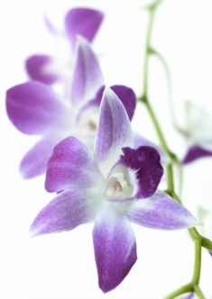
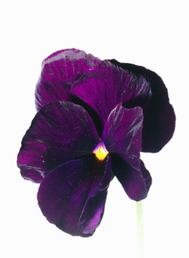
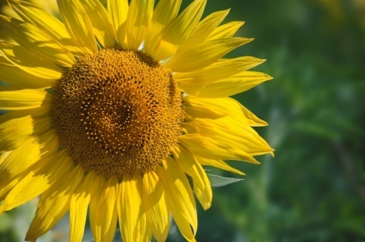
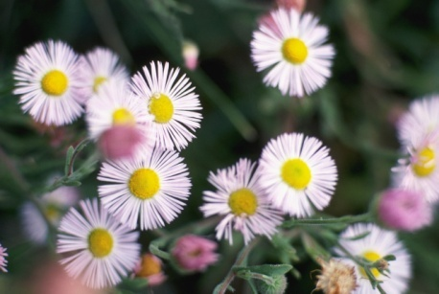


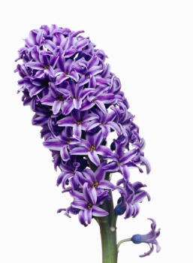
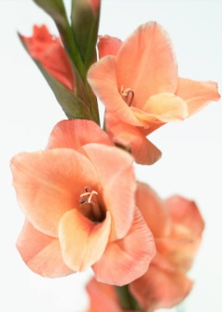

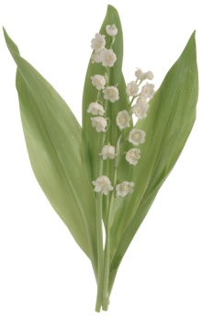

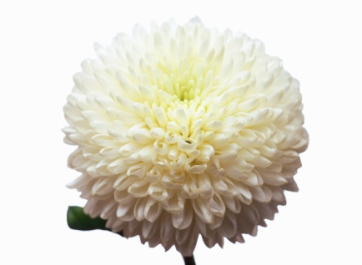
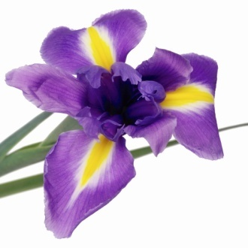
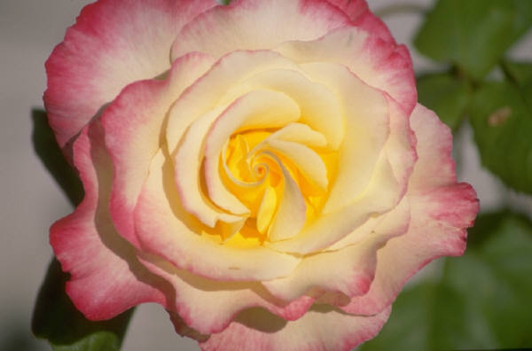

Slide 5
The following materials come from: http://www.challengingbehavior.org/do/resources/teaching_tools/ttyc.htm
This is a great site for materials for children with challenging behavior. Download the manual and the tool kit (toolkit is a zip file).

Slide 6
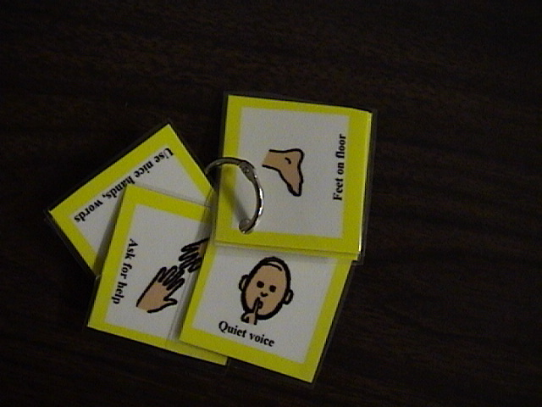
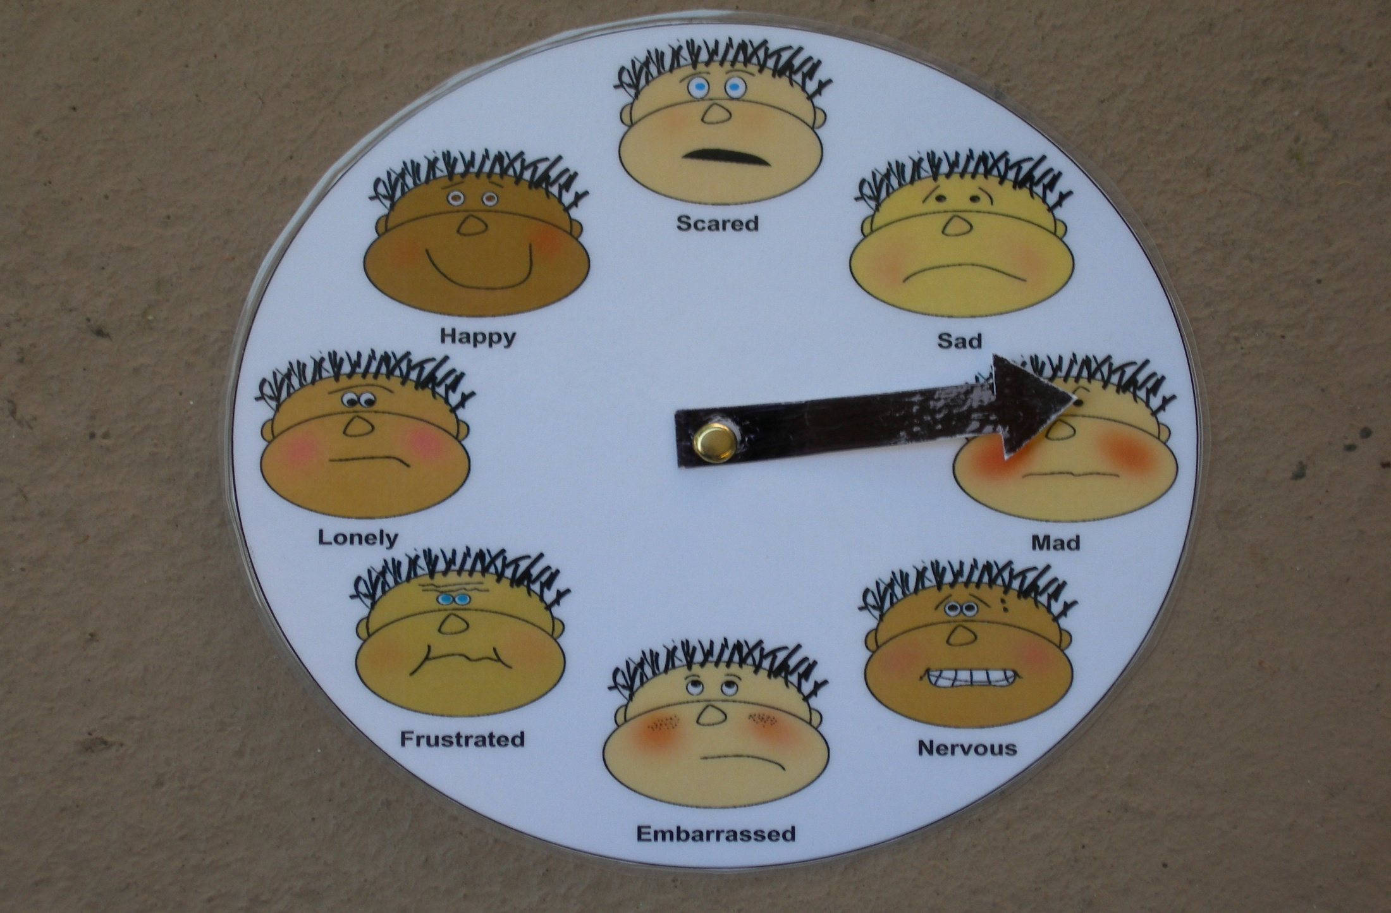

Teacher’s Visual Cue Cards
Feeling Wheel
Feeling Wheel
Lentini, R., Vaughn, B. J., & Fox, L. (2005). Teaching Tools for Young Children
with Challenging Behavior. Tampa, Florida: University of South Florida,
Early Intervention Positive Behavior Support.
Lentini, R., Vaughn, B. J., & Fox, L. (2005). Teaching Tools for Young Children
with Challenging Behavior. Tampa, Florida: University of South Florida,
Early Intervention Positive Behavior Support.
Lentini, R., Vaughn, B. J., & Fox, L. (2005). Teaching Tools for Young Children
with Challenging Behavior. Tampa, Florida: University of South Florida,
Early Intervention Positive Behavior Support.

Slide 7
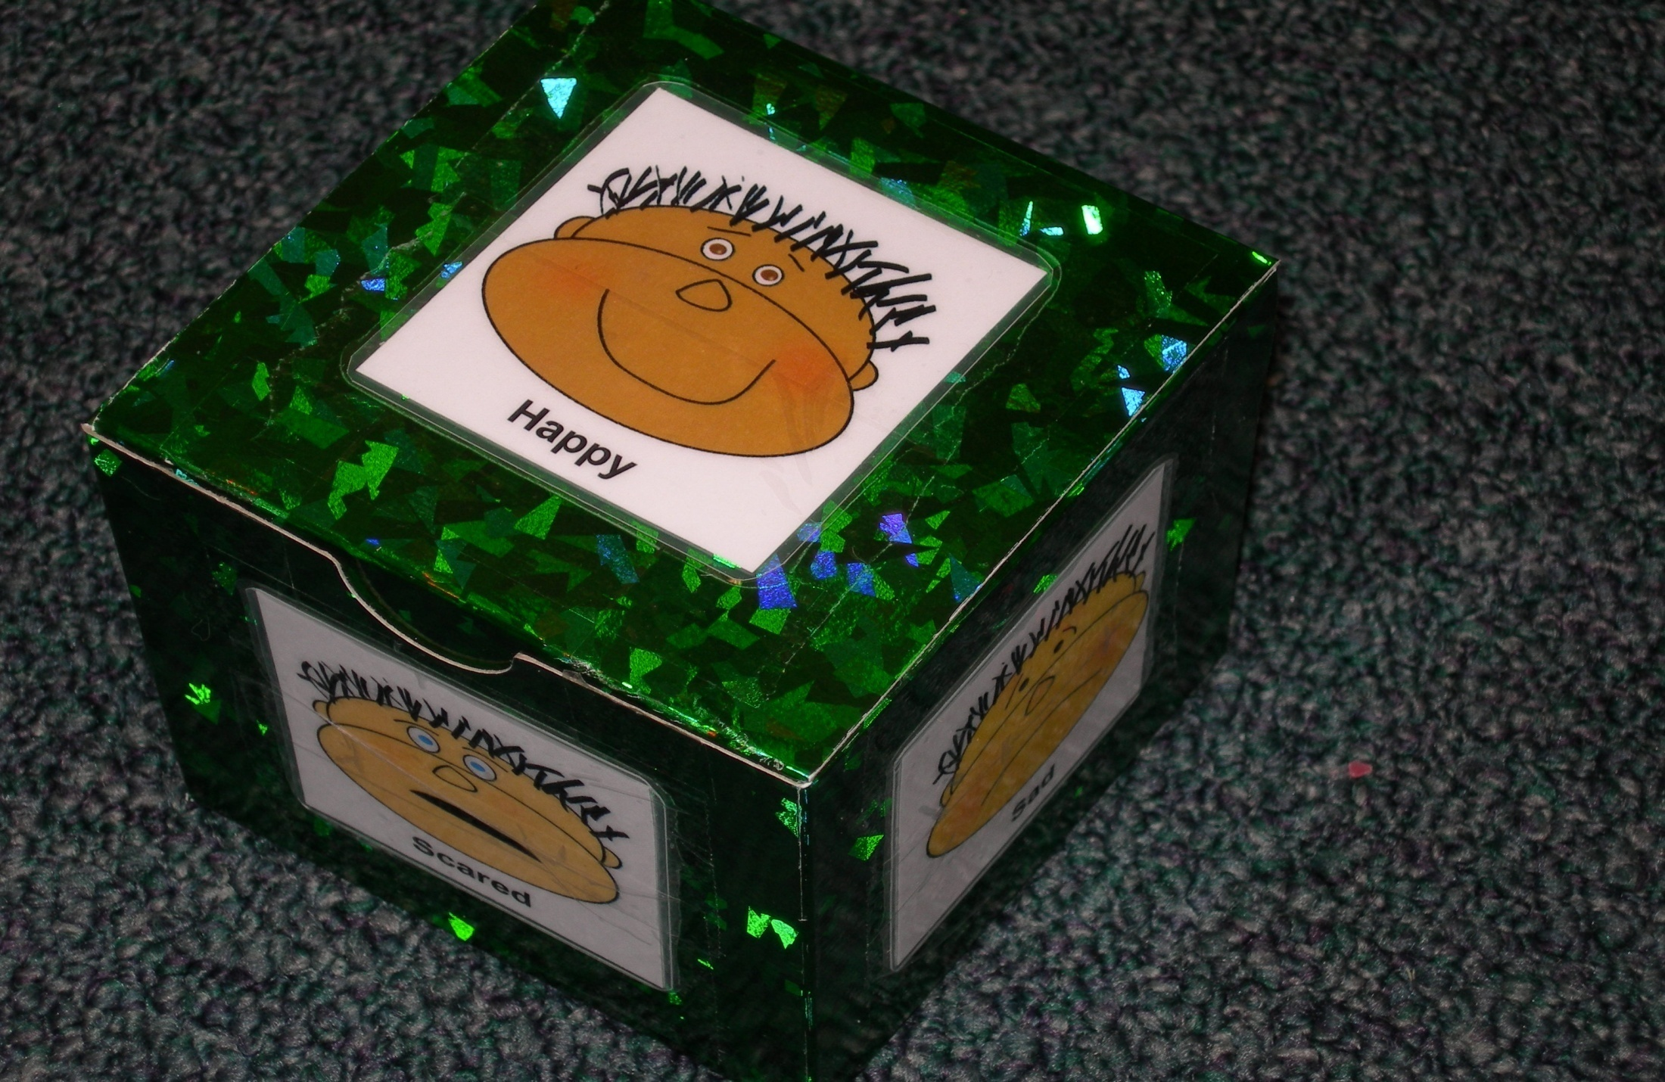
Feeling Dice
Lentini, R., Vaughn, B. J., & Fox, L. (2005). Teaching Tools for Young Children
with Challenging Behavior. Tampa, Florida: University of South Florida,
Early Intervention Positive Behavior Support.

Slide 8
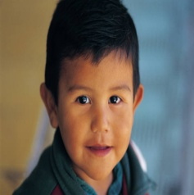

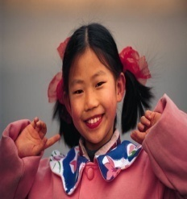
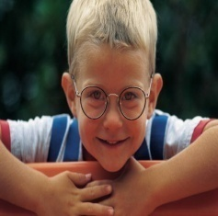
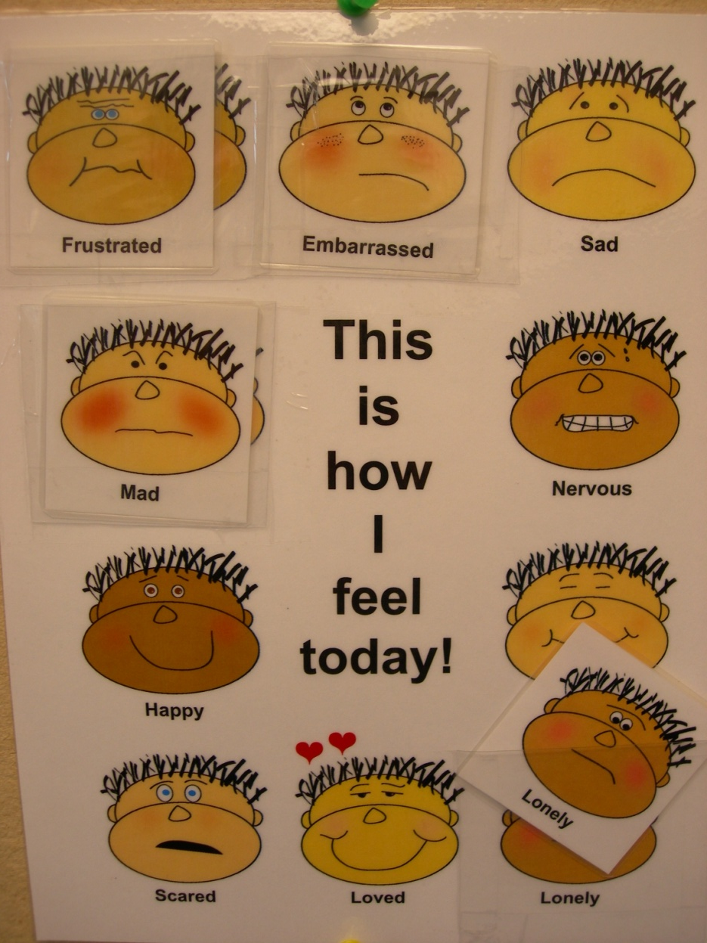
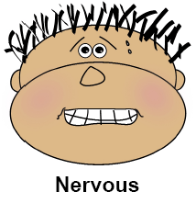
Feeling Check-In Board
How do you feel today?
Lentini, R., Vaughn, B. J., & Fox, L. (2005). Teaching Tools for Young Children
with Challenging Behavior. Tampa, Florida: University of South Florida,
Early Intervention Positive Behavior Support.

Slide 9
Teacher’s Visual Cue Cards
Lentini, R., Vaughn, B. J., & Fox, L. (2005). Teaching Tools for Young Children
with Challenging Behavior. Tampa, Florida: University of South Florida,
Early Intervention Positive Behavior Support.

Slide 10
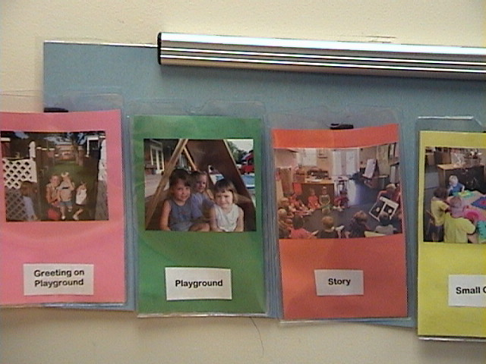
Photograph Visual Schedule in Clear Pockets
Lentini, R., Vaughn, B. J., & Fox, L. (2005). Teaching Tools for Young Children
with Challenging Behavior. Tampa, Florida: University of South Florida,
Early Intervention Positive Behavior Support.

Slide 11
Tucker Turtle and What do I do in circle
The following are the first few pages/slides two different books that teachers can print and use for very particular teaching. Tucker Turtle teaches children the turtle method for anger management/self-regulation. The circle book gives children ability to “practice” thinking about and describing circle behavior. The entire books are available from the tool kit.

Slide 12
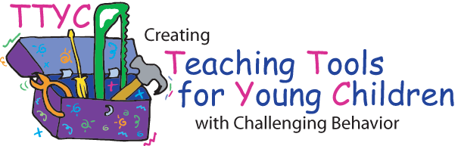
Tucker Turtle Takes Time to Tuck and Think
A scripted story to assist with teaching the “Turtle Technique”
By Rochelle Lentini
March 2005
Lentini, R., Vaughn, B.J., & Fox, L. (2005). Teaching Tools for Young Children with Challenging Behavior. University of South Florida.
Created using pictures from Microsoft Clipart® and Webster-Stratton, C. (1991). The teachers and children videotape series: Dina dinosaur school. Seattle, WA: The Incredible Years.

Slide 13
Tucker Turtle is a terrific turtle. He likes to play with his friends at Wet Lake School.

Slide 14
But sometimes things happen that can make Tucker really mad.

Slide 15
Teacher Tips on the Turtle Technique
Model remaining calm
Teach the child the steps of how to control feelings and calm down (“think like a turtle”)
  Step 1: Recognize your feeling(s)
  Step 2: Think “stop”
  Step 3: Tuck inside your “shell” and take 3 deep breaths
  Step 4: Come out when calm and think of a “solution”
Practice steps frequently (see cue cards on next 4 pages)
Prepare for and help the child handle possible disappointment or change and “to think of a solution” (see list on last page)
Recognize and comment when the child stays calm
Involve families: teach the “Turtle Technique”
Webster-Stratton, C. (1991). The teachers and children videotape series: Dina dinosaur school. Seattle, WA: The Incredible Years.

Slide 16
Step 1

Slide 17
STOP
Step 2

Slide 18
Step 3

Slide 19
Step 4

Slide 20
What Do We Do In Circle?
Created by Rochelle Lentini, USF
Updated 2004
Lentini, R., Vaughn, B. J., & Fox, L. (2005). Teaching Tools for Young Children
with Challenging Behavior. Tampa, Florida: University of South Florida,
Early Intervention Positive Behavior Support.
Created using pictures from Microsoft Clipart®

Slide 21
Everyone can go to circle and sit on their seat.

Slide 22
Sometimes it is hard for me to sit. But I can look at my “sit picture” and try to remember to sit, like all my friends, at my seat.
If I get up off my seat, it is hard for
my friends to see and have fun.

Slide 23
“What do we do in circle?”
When the teacher talks, I sit nice and listen.
First
Then
First the teacher points to me, then I can answer with words.
When the class sings, I can sing.
When the class dances, I can dance.

Slide 24
Glue on photograph of child sitting.
OR
Sit.
Sit.
Cut out “sit picture”, laminate, place rough Velcro on back side, and Velcro to carpet in front of child’s seat in circle. This will act as a visual cue to the child. The teacher can also pick up the picture to show and cue the child to sit.
Lentini, R., Vaughn, B. J., & Fox, L. (2005). Teaching Tools for Young Children
with Challenging Behavior. Tampa, Florida: University of South Florida,
Early Intervention Positive Behavior Support.

Slide 25
Additional resources
I’ve added a few web sites with some ideas that I thought could be viable. I do not say that activities created based on these ideas will automatically be great – but they have some good starting ideas.

Slide 26
Direct quote from the web site below:
“COOPERATIVE PLAY: I love games that do not include competition. So when we would play this game we played like the Three Little Pigs who had to escape the wolf. They needed to work together and so do we. When a player successfully gets his pig to the apple, he continues taking his turns as before. However, he helps out the others, by moving whichever pig is still the furthest from the finish.”
http://www.angelfire.com/wi2/GamesForLearning/gamepages/velcropigs.html

Slide 27
http://www.essortment.com/all/learningfilefo_rhml.htm
http://www.abcteach.com/free/c/colormatching_butterflies_bw.pdf
http://www.abcteach.com/free/g/game_caterpillar_counting_color.pdf

