Slide 1
Ridiculously Simple Time Series Forecasting
We will review the following techniques:
Simple extrapolation (the “naïve” model).
Moving average model
Weighted moving average model

Slide 2

The Naïve Model
If your time series exhibits little variation
from one period to the next, has
no discernible trend, and is unaffected by
seasonality, the naïve model
is just what you need.

Slide 3

The Moving Average Model
For example, if n = 4, you have a 4-period moving average model.

Slide 4

The Weighted Moving Average Model
The ω’s are the weights attached to past observations of the time series variable and there are n periods weighted. Notice that: Σω_{i} = 1.
The trick is to select the value
of n and corresponding
values of so as to minimize
MSE

Slide 5
Example: Forecasting Retail Sales of Women’s Clothing
Our data set contains 175 monthly observations on retail sales of women’s clothing in the U.S. (January 1996 to August 2010) measuring in millions of dollars.
We will perform in-sample forecasts using the 3 techniques to determine which has the best fit.

Slide 6
Techniques 2 and 3
We will do a 6-month prior moving average for technique 2
We will do a 4-month weighted moving average for technique 3. The weights are as follows:

Slide 7
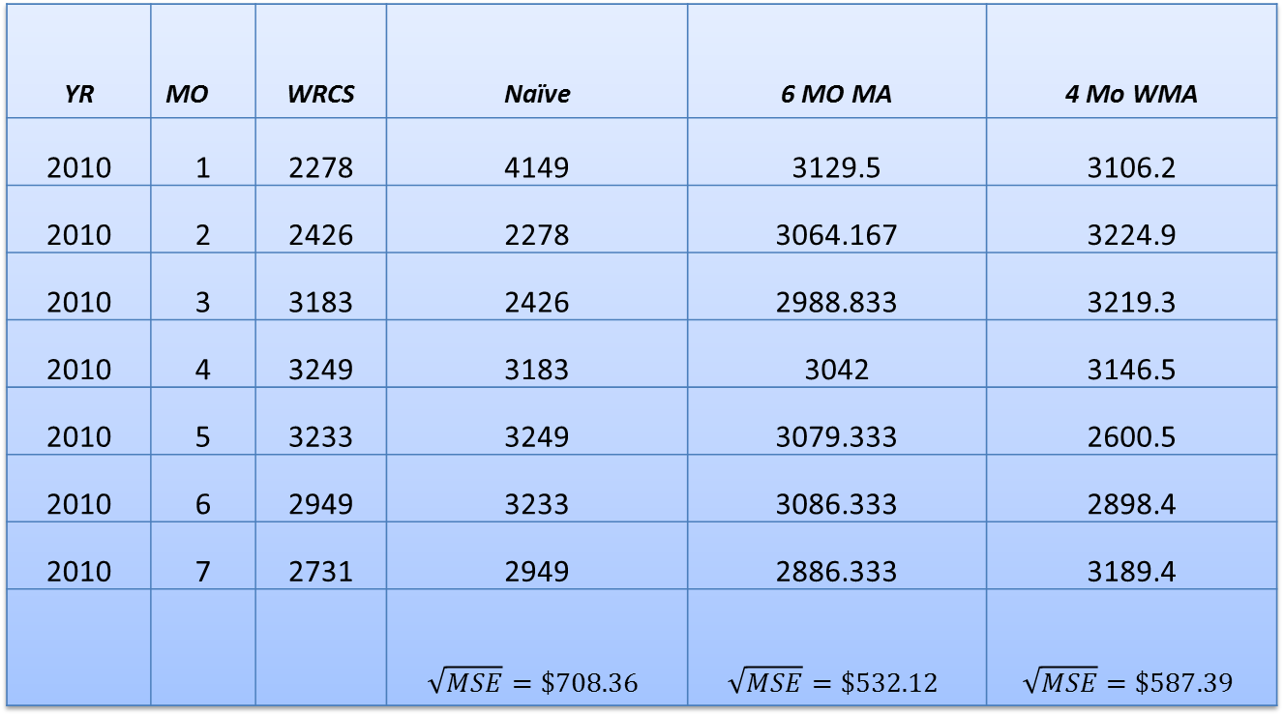
Results
Results
YR | MO | WRCS | Naïve | 6 MO MA | 4 Mo WMA
2010 | 1 | 2278 | 4149 | 3129.5 | 3106.2
2010 | 2 | 2426 | 2278 | 3064.167 | 3224.9
2010 | 3 | 3183 | 2426 | 2988.833 | 3219.3
2010 | 4 | 3249 | 3183 | 3042 | 3146.5
2010 | 5 | 3233 | 3249 | 3079.333 | 2600.5
2010 | 6 | 2949 | 3233 | 3086.333 | 2898.4
2010 | 7 | 2731 | 2949 | 2886.333 | 3189.4
 |  |  | $$\sqrt{MSE}=\$708.36$$ | $$\sqrt{MSE}=\$532.12$$ | $$\sqrt{MSE}=\$587.39$$

